Slide 1
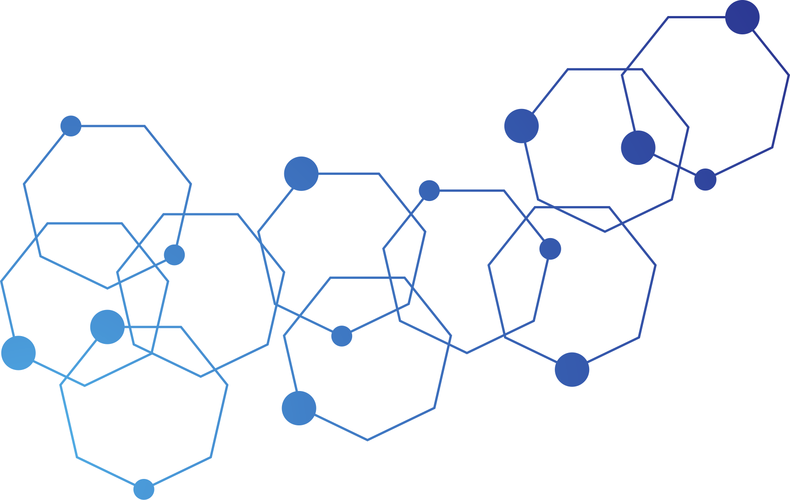



Group-C
Welcome To Our
Presentation
Thank you for joining us today. In this presentation, we'll share key insights, ideas, and information on our topic. Stay engaged as we explore and discuss together.
Read More
EMS-(Employee Management System)
Page 1

Slide 2
Group-C
Our Group Memebers
(2022-3-60-242)
Kawser Ahmed (2022-3-60-242)
Md. Romjan Ali (2022-3-60-247)
Raqibul Hasan (2022-3-60-261)
Jobeir Ahmed Dip (2022-3-60-307)
Mehedi Hasan Tapu (2021-2-60-154)
Arafat Islam (2022-3-60-303)
EMS-(Employee Management System)

Slide 3

Group-C
Introduction
An employee management system streamlines data handling, task tracking, performance monitoring, and overall workforce efficiency.
EMS-(Employee Management System)
Page 2

Slide 4

Group-C
What is an Employee Management system?
Why is it important ?
Page 3
EMS-(Employee Management System)

Slide 5
Group-C
Our Featrues
Add New Employee Record
01
Presentations are tools that can be used
Search record from employee ID
02
Presentations are tools that can be used
List Employee of particular department
03
Presentations are tools that can be used
Display all employees
04
Presentations are tools that can be used
Page 4

Slide 6
Group-C
Our Featrues
Update record of an employee
05
Presentations are tools that can be used
Delete record of particular employee
06
Presentations are tools that can be used
Find Employees by Rating
07
Presentations are tools that can be used
GCD of Employee IDs
08
Presentations are tools that can be used
Page 5

Slide 7
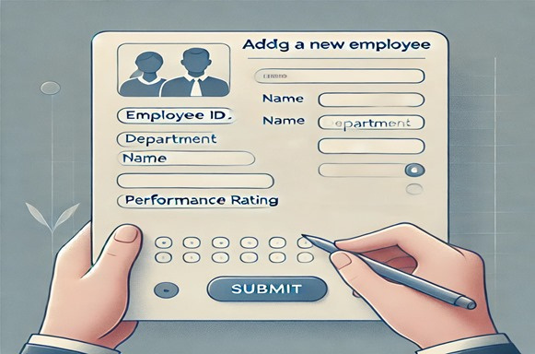
Group-C
Add New Employee Record
Quickly add and store new employee details, ensuring accurate records for streamlined workforce management
Page 6
EMS-(Employee Management System)

Slide 8
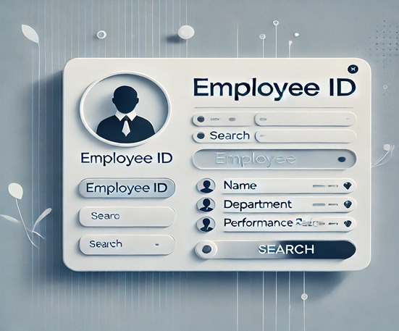
Group-C
Search record from Employee ID
Efficiently retrieve employee information by entering their unique ID, ensuring quick access to accurate records
Page 7
EMS-(Employee Management System)

Slide 9

Group-C
List Employee of particular department
View a detailed list of employees categorized by department for organized and efficient management.
Page 8
EMS-(Employee Management System)

Slide 10
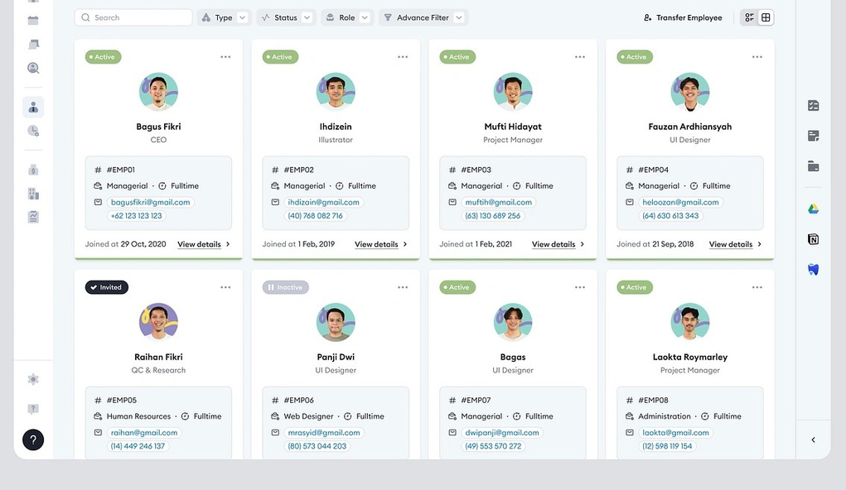
Group-C
Display all employees
Show a comprehensive list of all employees with their details for streamlined overview and management
Page 9
EMS-(Employee Management System)

Slide 11


Group-C
2023
Update record of an employee
Modify and update employee details efficiently, ensuring accurate and up-to-date records in the system.
Page 10
EMS-(Employee Management System)

Slide 12
Group-C
2023
Delete record of particular employee
Remove specific employee records securely and efficiently, ensuring data accuracy and maintaining organized information.
Page 11
EMS-(Employee Management System)

Slide 13

Group-C
Find Employees by Rating
Remove specific employee records securely and efficiently, ensuring data accuracy and maintaining organized information
Page 12
EMS-(Employee Management System)

Slide 14
Group-C
GCD of Employee IDs
Calculate the greatest common divisor (GCD) of employee IDs for unique data analysis and organization.
Example: 2022-3-60-242
Page 13
EMS-(Employee Management System)

Slide 15

Group-C
Time and Space Complexity
quick sort and merge sort O(nlog n)
selection sort and merge sort O(n2)
Space complexity O(n)
Page 15
EMS-(Employee Management System)

Slide 16

Group-C
Thanks

